Slide 1


Smart Sh wer
Because Every Drop Counts
~Team CRONOZ

Slide 2
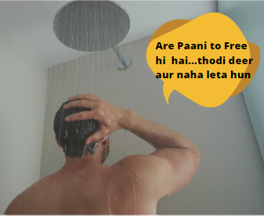
The current ideation of people-
Most of the people, who use shower to take bath, already knew that by using shower they waste a lot of water. But still they don’t understand the value of water and still use shower to bath.

Slide 3
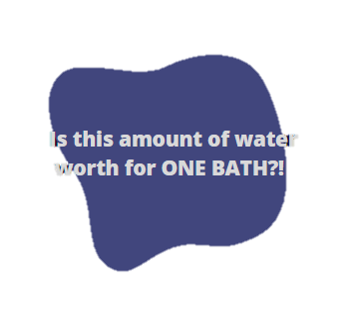
Water usage Per Bath using shower-
The average shower water usage is 17.2 (65.1 L) gallons with the average shower length being 8.2 minutes. The average flow rate is 2.1 (7.9 L) gallons per minute.*
* Reference From ~ https://bit.ly/2Nvy8Uo

Slide 4
To solve this problem we thought of making a SMART SHOWER which will encourage many minds and, we also planned to make an rewarding for the same in which the amount of saved water (10 L = 10 Points) will be converted into some token which can be later used to redeem in place of some gift cards or offer coupons so that more people would like to avail in this program.

Slide 5
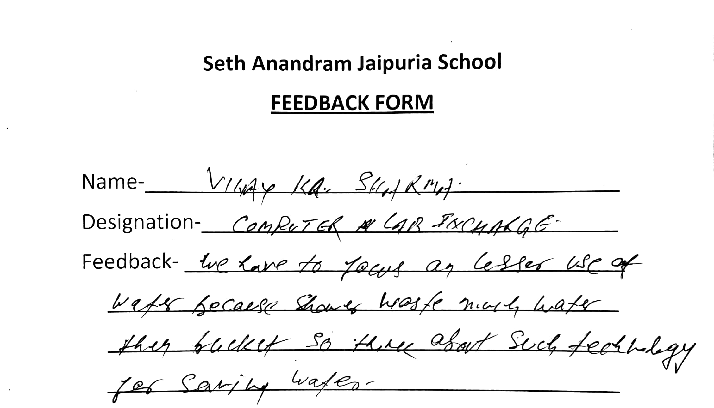
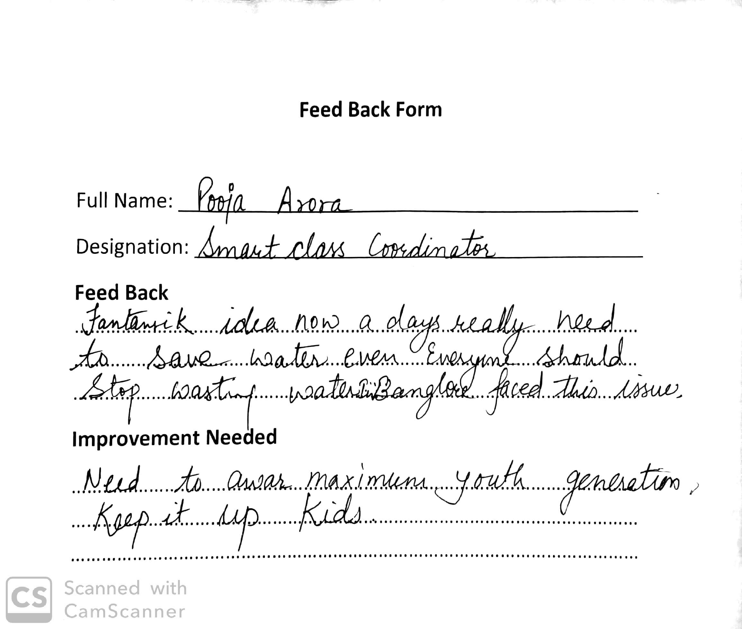
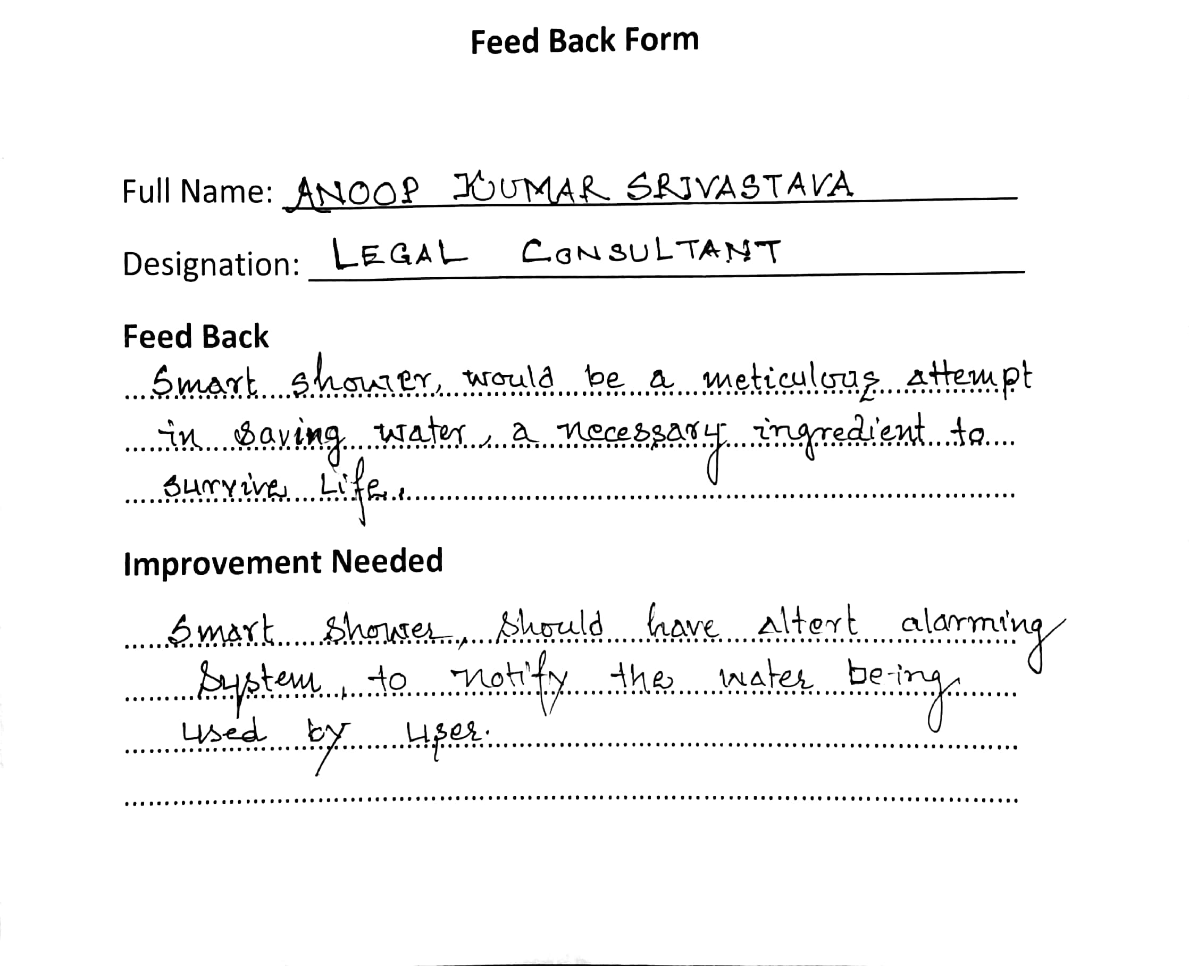
So First we took FEEDBACK from our seniors so that we can know how can we improve this project~

Slide 6
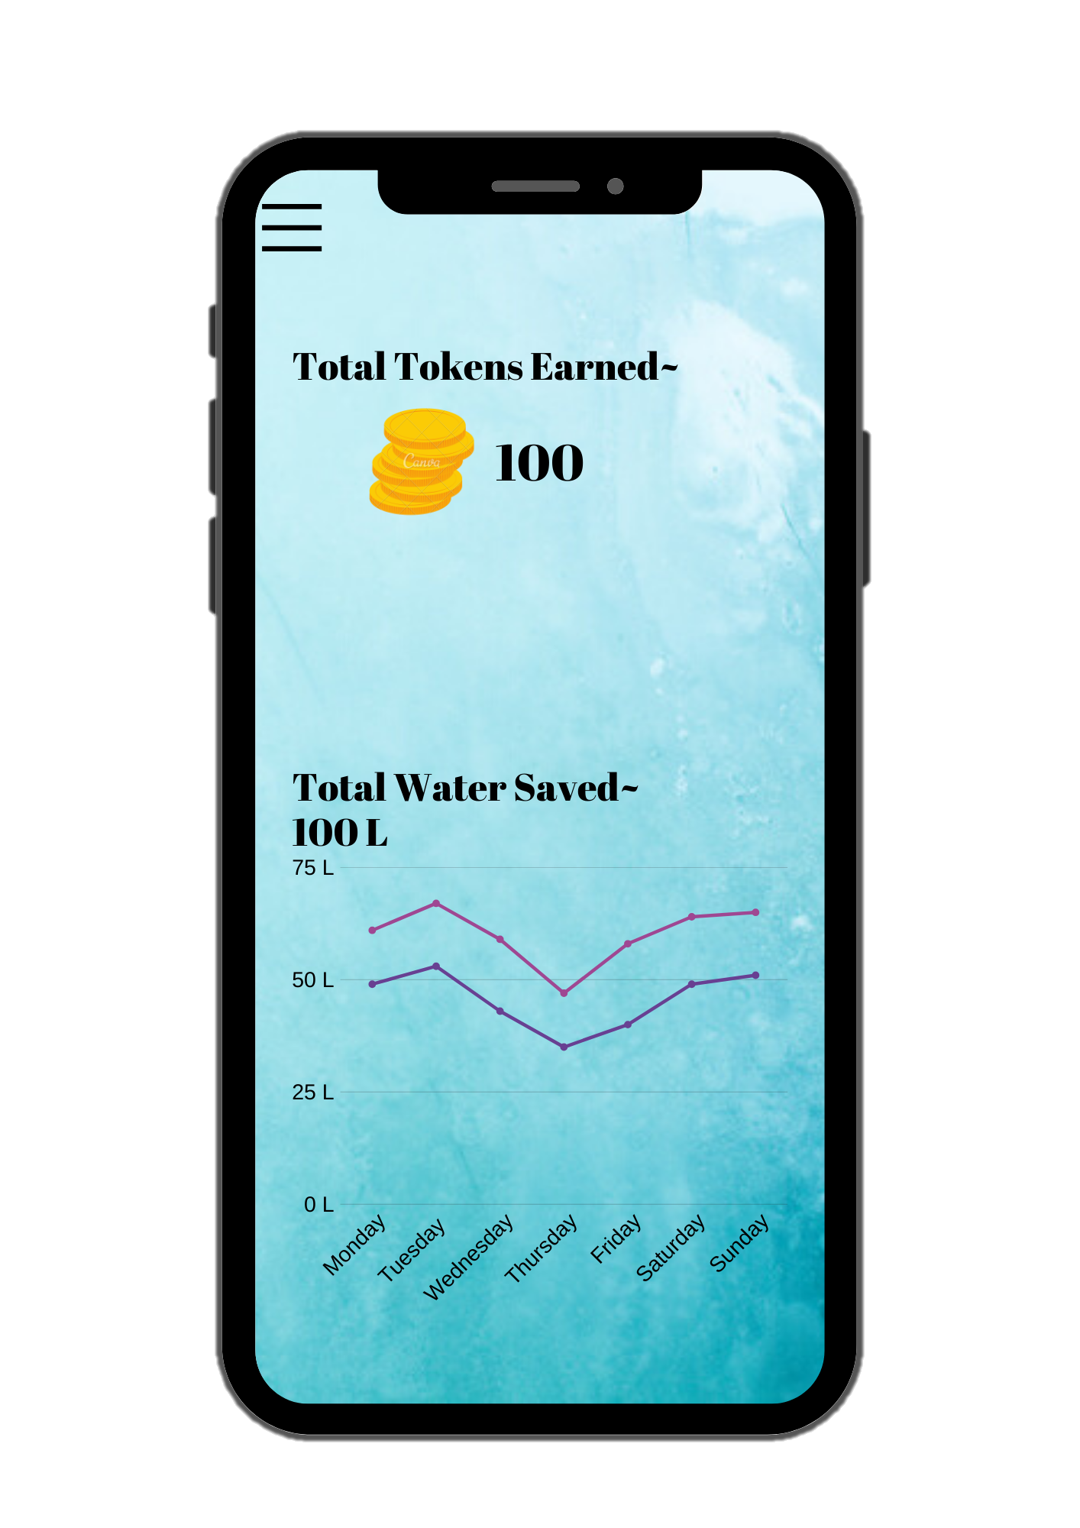
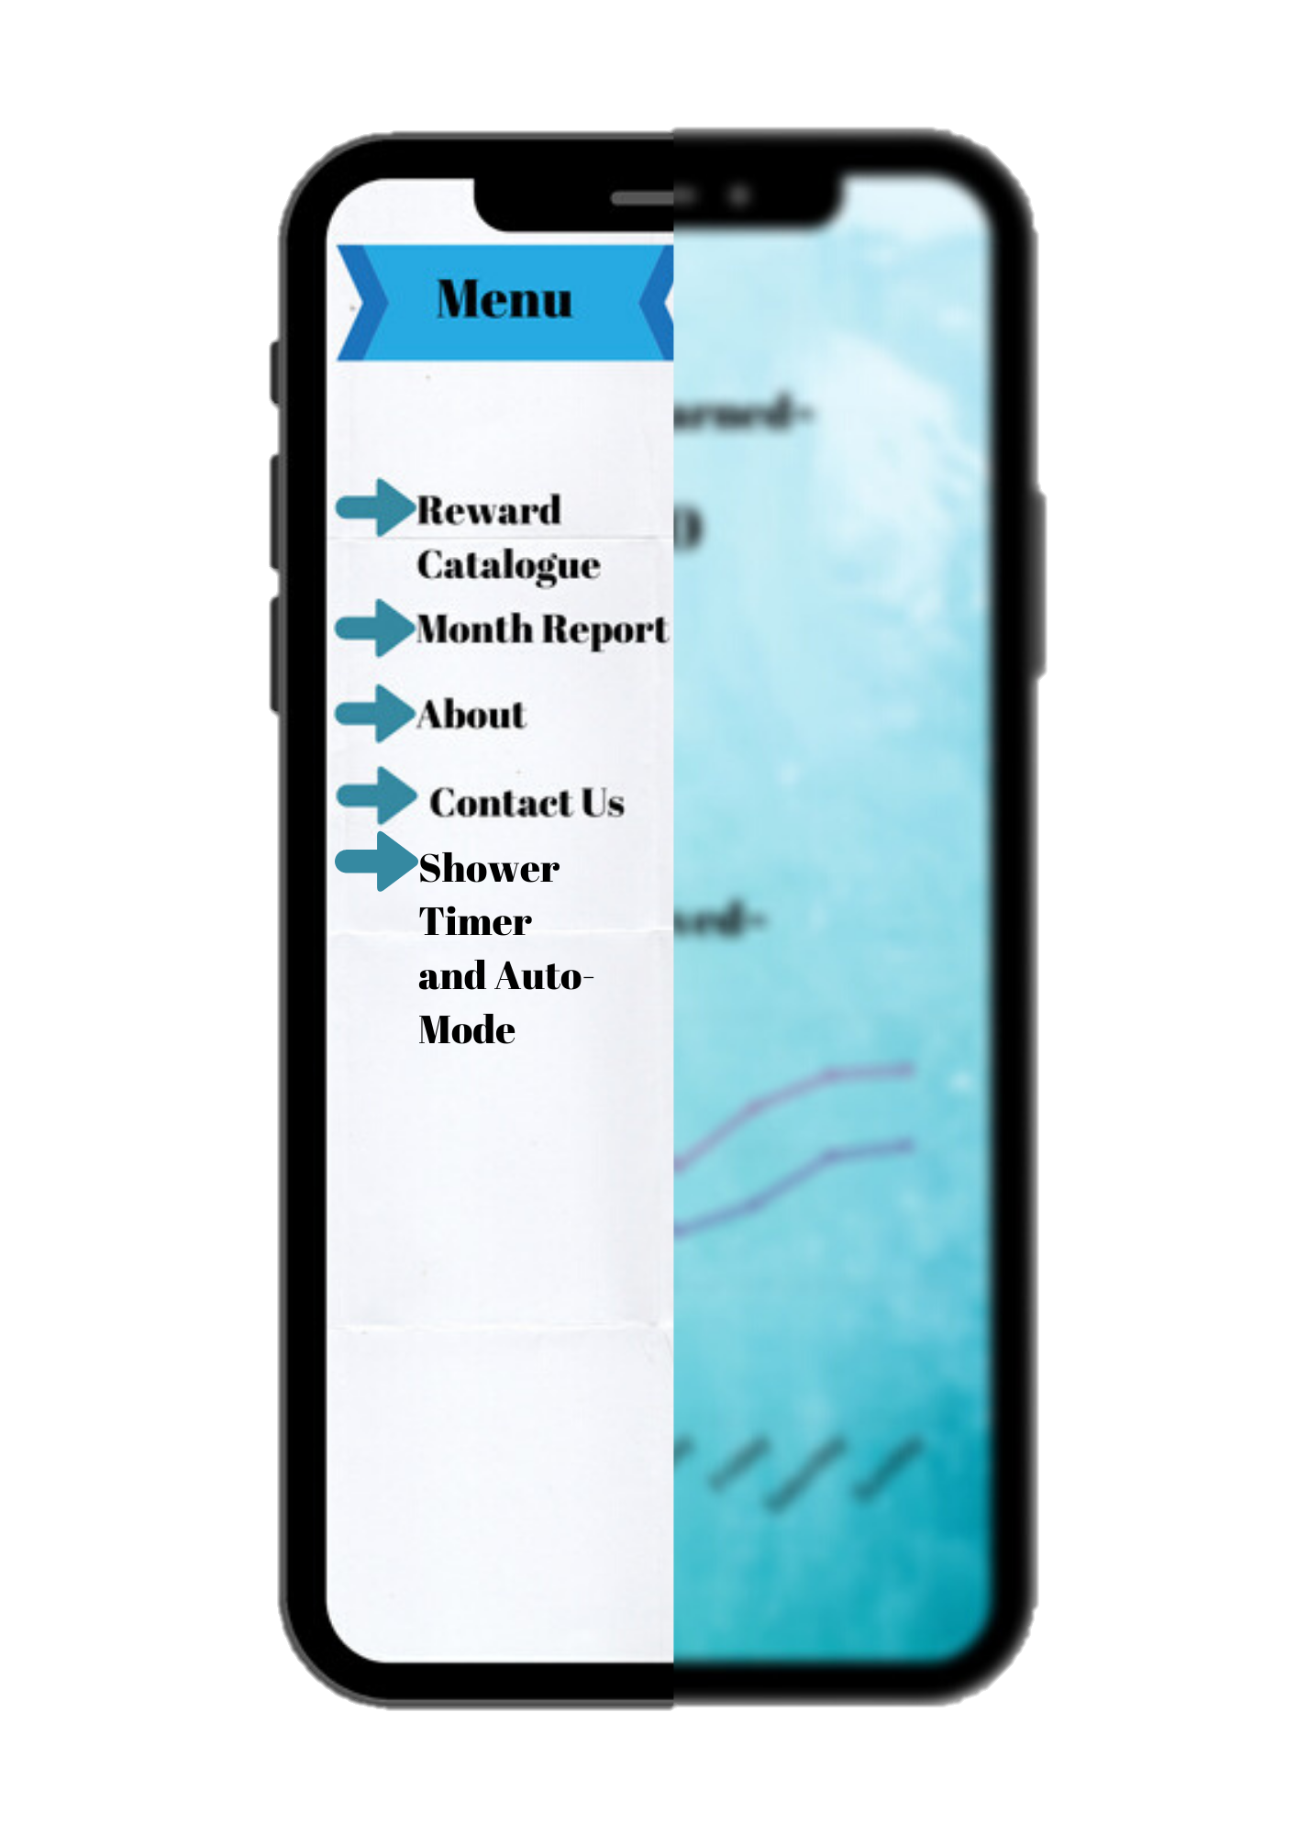
App Layout~

Slide 7
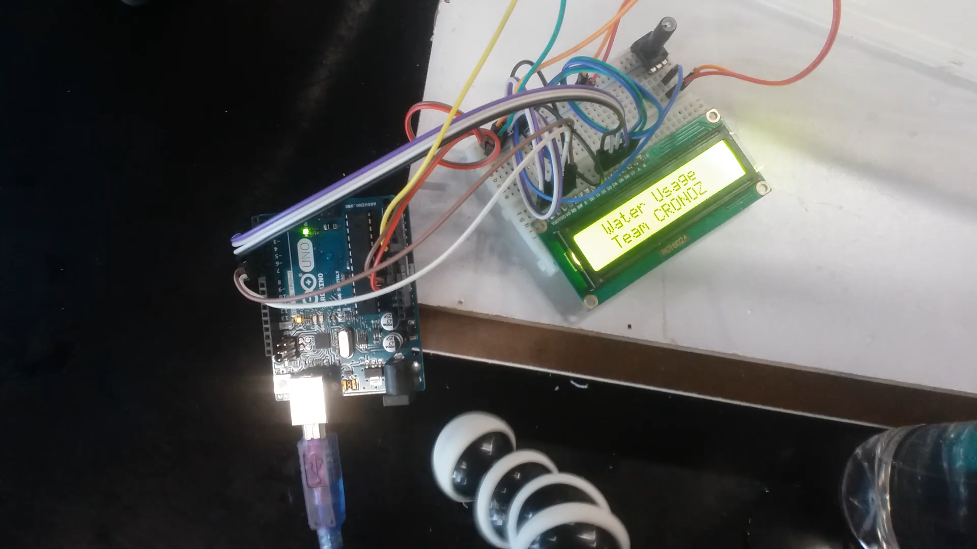
Working of Prototype

Slide 8
Future Improvements
Will add TFT display to the shower for better and easy use.
Will be using Raspberry Pi/Nodemcu so that we can get more accuracy and reliability.
The app will be connected to the shower to get data from Raspberry Pi or Nodemcu.
There will be an rewarding systemin the shower and if the person save 10 liters of water, the user will be rewarded 10 token which he/she can convert into gift cards and vouchers.

Slide 9
Marketing
Collaborate With Shower Companies.
Collaborate With Government to do Virtual Trade.

Slide 10
Comparison
 | Simple Shower | Smart Shower
Cost | Rs. 700 | Rs. 950
Water Usage | 17 gallon apx. | 8.5 gallon apx.
Modes | Simple one and only mode | Multiple modes
Rewarding | None | Gift cards/ Vouchers
Space | Less space is required | More space is required than simple shower.
IOT | None | Yes, sends the usage of water to user’s phone.
Power Supply | None | Requires power supply.

Slide 11
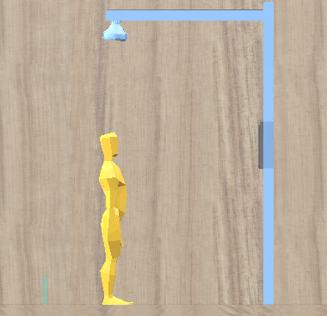
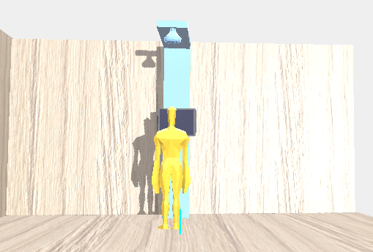
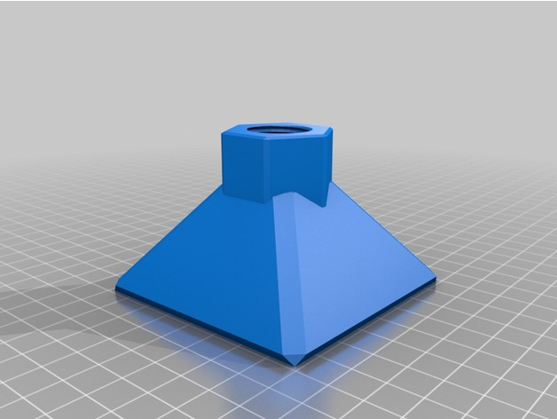
3D Files

Slide 12

Aryanshh Srivastava
Aakarsh Tripathi
Sambhav Sirohi
092_Cronoz

